Slide 1
Spam Email Filtering System
Leveraging Machine Learning to Classify Spam and Non-Spam Emails
Name
Date
Datasets from: https://www.kaggle.com/datasets/tapakah68/email-spam-classification/data

Slide 2

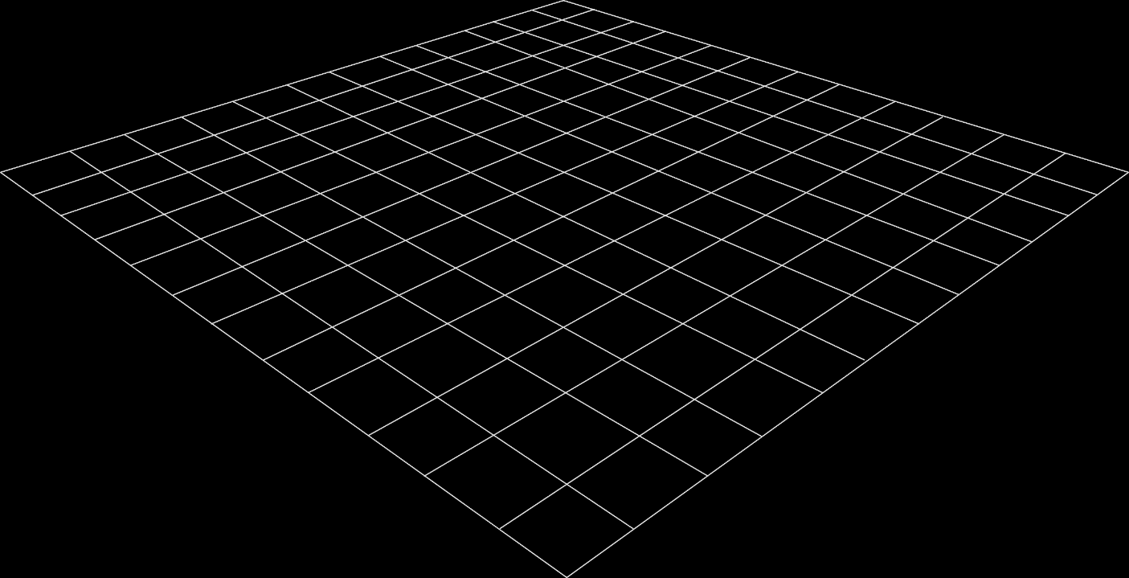
Problem Statement & Objectives
Problem: Spam emails negatively impact productivity by cluttering inboxes.Spam emails pose security risks by containing malware or phishing attempts.
Objective: Use machine learning to automatically classify emails as either spam or non-spam, reducing manual filtering and improving user efficiency and security.

Slide 3
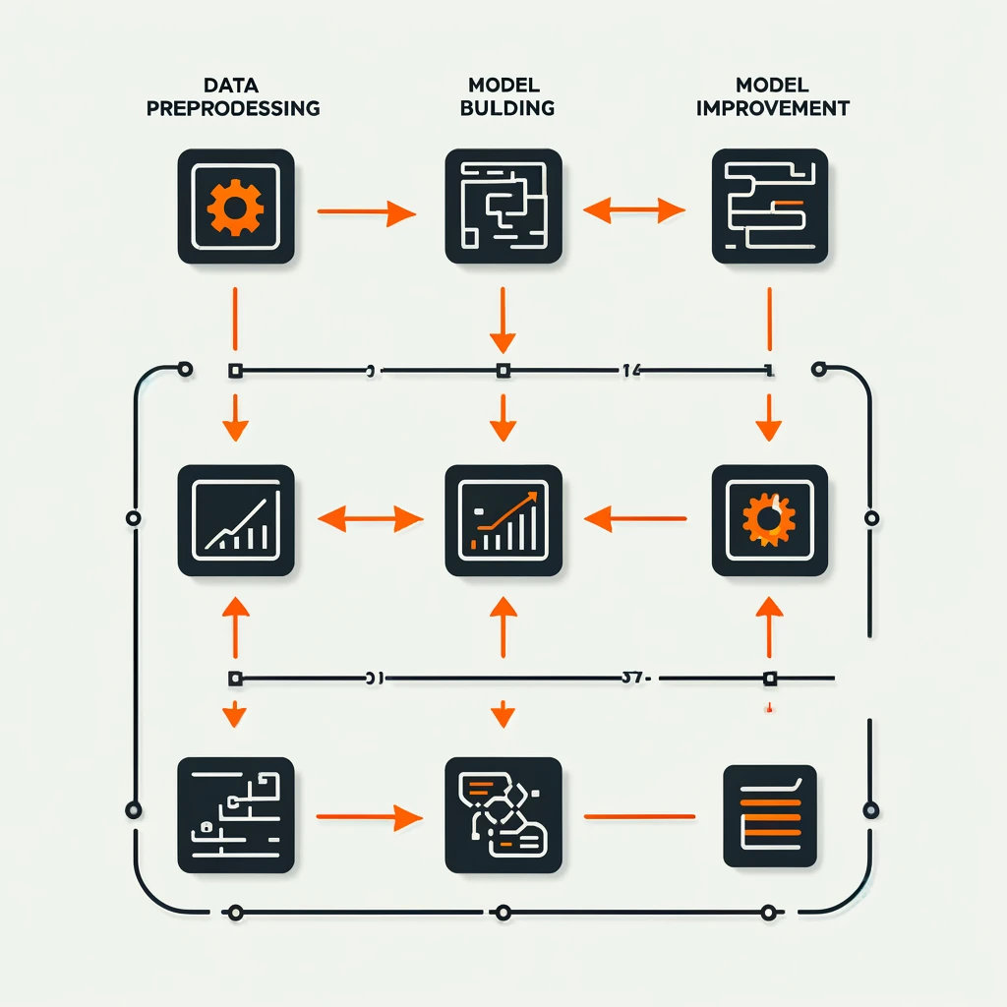
Methodology
Data Preprocessing:
  Cleaned email text by removing URLs and special characters.
  Used TF-IDF Vectorization (unigrams and bigrams).
  Split data into training and test sets (80/20 split).
Model Development:
  Built two models: Logistic Regression and Linear Regression
  (adapted for classification).
Model Improvement:
  Applied SMOTE to address class imbalance.
  Optimized hyperparameters using GridSearchCV.
  Adjusted classification threshold to improve recall for spam.

Slide 4
Results & Findings: Logistic vs. Linear Regression
Findings:
Linear Regression achieved better overall accuracy (94%) compared to Logistic Regression (88%).
Precision for detecting spam (Class 1) was higher with Linear Regression (100%) than Logistic Regression (75%), indicating Linear Regression classified spam emails more correctly without false positives.
Recall for spam was higher with Logistic Regression (100%) than Linear Regression (83%). This shows Logistic Regression caught all spam emails but misclassified more non-spam as spam.
F1-Score was also higher for Linear Regression (0.91) for spam, showing a better balance between precision and recall.
Conclusion: While Logistic Regression caught more spam (higher recall), Linear Regression was more accurate overall, and with higher precision, making it more reliable for spam classification.
Metric | Logistic Regression | Linear Regression
Accuracy | 88% | 94%
Precision (Spam) | 75% | 100%
Recall (Spam) | 100% | 83%
F1-Score (Spam) | 0.86 | 0.91

Slide 5
Conclusion
Linear Regression: Provided a better balance between precision and recall, making it more reliable for classifying spam and non-spam emails.It is more suitable for situations where minimizing false positives (correctly identifying non-spam emails) is critical.
Logistic Regression:While Logistic Regression was effective in catching all spam emails (high recall), it resulted in more misclassifications of non-spam emails.This model would be useful in cases where identifying every possible spam email is the highest priority, even at the cost of precision.
Key Takeaway:Trade-off between precision and recall: Linear Regression is a better all-rounder, but Logistic Regression could be preferable in scenarios where spam detection must be maximized at the expense of some accuracy.

Slide 6


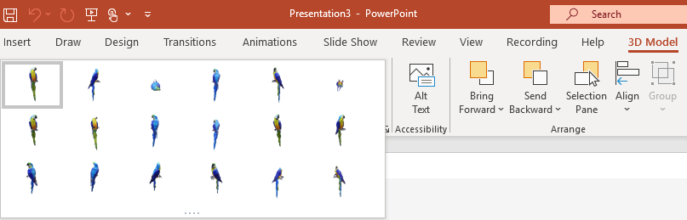
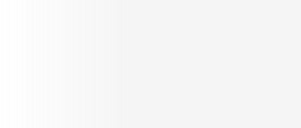
Two Ways to Position and Rotate Your 3D Model
Try them yourself with the parrot on the right:
1
Click on your 3D Model: Click and hold on the 3D control to rotate or tilt your 3D model up, down, left, and right.
3D Control
2
Alternatively, with your model selected, on the Ribbon, in the 3D Model Tool Format tab, you can click on 3D Model Views gallery to apply one of the various position views.

Slide 7



Pan and Zoom
To resize or crop your 3D model within a frame, you can use the pan and zoom tool.
1
Select your 3D model > 3D Model > Pan & Zoom
Note: the Pan & Zoom tool acts like an on/off (toggle) switch. Once pressed, you’ll see a grey box around the Pan & Zoom button to indicate the feature is activated. Press the button again to deactivate the Pan & Zoom feature.
2
With the Pan & Zoom button enabled, now move, rotate, and resize your 3D model.
3
When you are finished editing, click the Pan & Zoom button again to exit Pan and Zoom mode.

Slide 8
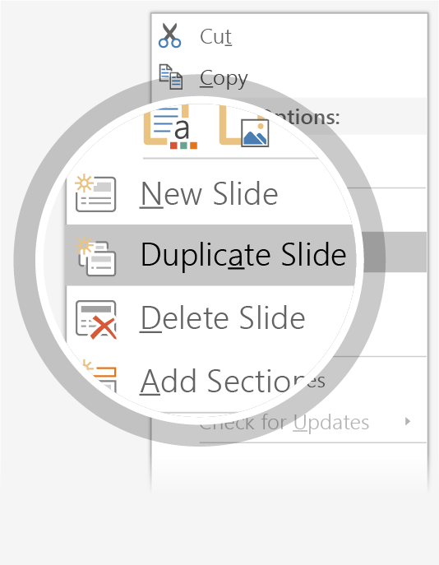

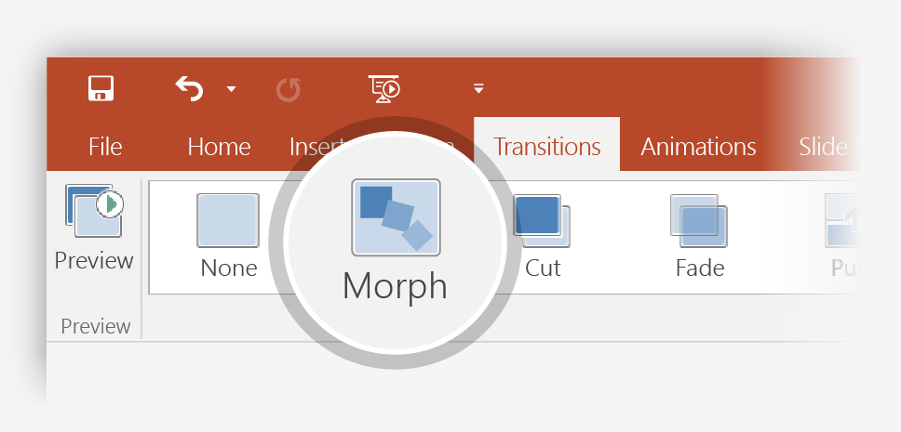
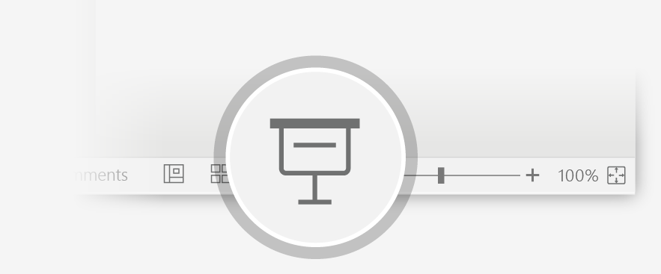
Now Animate Your 3D Model Using the Morph Transition
Try it yourself with the parrot on the right:
1
Duplicate this slide: Right-click the slide thumbnail and select Duplicate Slide.
2
In the second of these two identical slides, change the 3D Model on the right in some way (rotate, move, or resize), then go to Transitions > Morph.
3
Return to the first of the two slides and press the Slide Show button and then select Play to see your parrot morph!

Slide 9
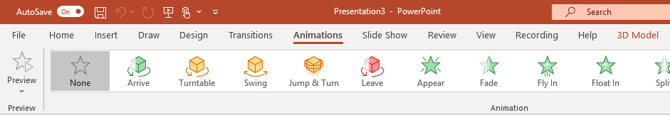
Animate Your 3D Model Using the Animations Tab
Try it yourself with the parrot on the right:
1
Select the 3D Model on the right, then go to Animations > Turntable
Hint: Effect Options gives you even more options for Turntable.
2
Explore the other new animations designed specifically for 3D models: Arrive, Swing, Jump & Turn, and Leave.
3
Click Add Animation to combine the new 3D animations with other classic 2D animations, such as Fade, Grow/Shrink, or one of the many Motion Paths animations to test and see what is possible.

Slide 10
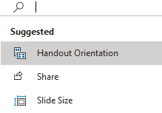


More questions about PowerPoint?
Select the Tell Me button and type what you want to know.
Visit the PowerPoint team blog
Go to free PowerPoint training
SELECT THE ARROW WHEN IN SLIDE SHOW MODE

